Slide 1
2026 vETERANS APPRECIATION WEEK
Saluting Veterans on America’s 250th Anniversary
Massing of the colors and nature coast community band (NCCB) event
Date: Sunday, OCT 25TH
Location: Seven Rivers Presbyterian Church, HWY 44, Lecanto, FL Time Schedule For Veteran Participants:
1:30 PM: Flag racks arrive. JROTC cadets position racks. Doors at rear of sanctuary are open. Drive to back to access doors.
2:00 PM: Front Doors Open. Units test flag poles in flag racks.
2:15 PM: Unit flags parade rest at church sanctuary entrance.
2:15-3:00 PM: Event attendees arrive and enter sanctuary.
3:00 PM: Event starts with MC directing program.
Dress: Military or Organization uniforms.
1

Slide 2
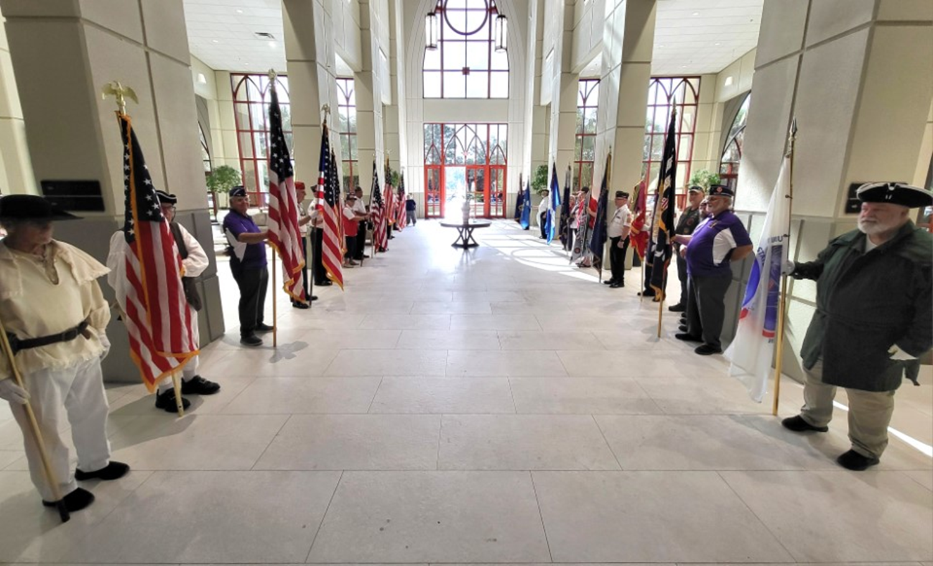







1:30 PM: Flag racks arrive. JROTC cadets (CAD) position racks.
2:00 PM: Units arrive for process briefing.
2:15PM: Narthex area. Flag bearers at parade rest. US flag on right and unit flag on left (as facing church sanctuary entry doors. Entrance Sequence
Grand Union Flag (GUF) stands on right side facing entry doors.
Sons of American Revolution (SAR)
Positions 1-10. Flags of Veteran Organizations (VO) flags.
VO7
VO7
VO6
ENTRANCE
VO6
VO 5
VO 5
VO 4
VO 4
V0 3
V0 3
VO 2
VO 2
VO 1
VO 1
S
A
R
Maximum number of participants is 12 sets of flag holder teams:
Grand Union Flag (GUF)
Sons of the American Revolution (SAR) U.S flag and Unit flag
Veteran Organizations (10): Ten, 2 person teams of U.S. flag and Unit flags
2

Slide 3
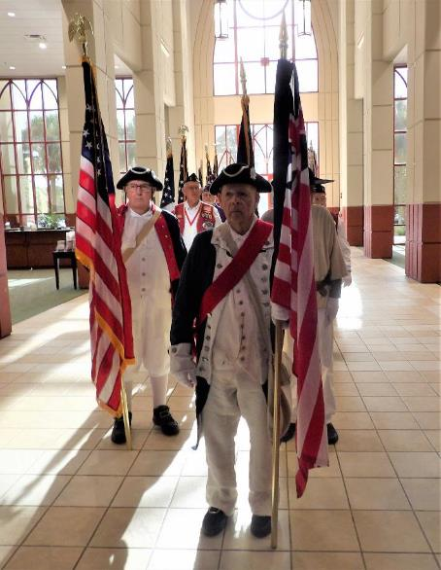
Massing of the Colors Entry March Process
3:00 PM: Flag personnel move from their parade rest Narthex positions to flag entry march positions led by by GUF followed by SAR U.S. and unit flags followed by VO U.S. and Unit flags.
NCCB: Opening narration/MC introduction.
MC: Opening brief welcome remarks.
MC: “Please stand for the Invocation”.
MC: After Invocation “Please be seated.”
MC: Brief Military flag history and history of Veterans Appreciation Week theme.
MC: “The Nature Coast Community Band (NCCB) will initiate the procession of flags. JROTC cadets (CADs) will participate in the racking of the flags.”
MC: “Ladies and Gentlemen, please rise for the presentation of the flags and remain standing for the singing of our national anthem by:________. Upon my command, place your right hand over your heart. Veterans may present arms with a hand salute.”
MC: “Present Arms”.
NCCB: Starts playing entry music.
GUF: Starts marching to center stage aisle position.
SAR unit followed by VO units march down center aisle with 10‘ intervals between each unit.
CADs (two on each side) will move to racking positions on stage and salute flags.
3

Slide 4
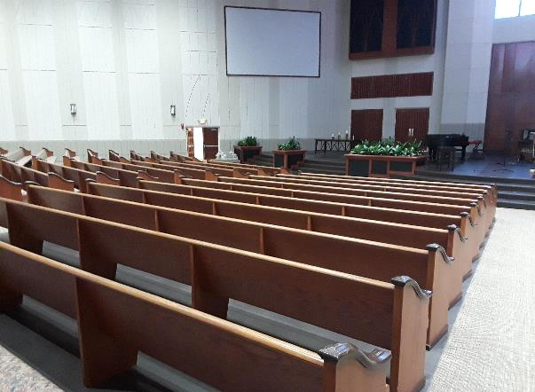
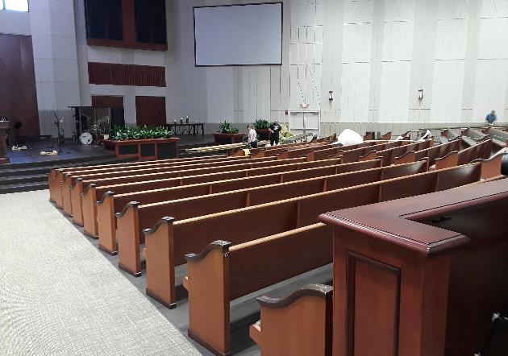




Massing of the Colors Entry March Process
US Flags
Unit Flags
NCCB starts playing entry music
GUF: starts marching to assume center stage floor position.
SAR marches in 10 feet from GUF followed by VO units 10-foot intervals between each set of flags.
G
U
F
4

Slide 5
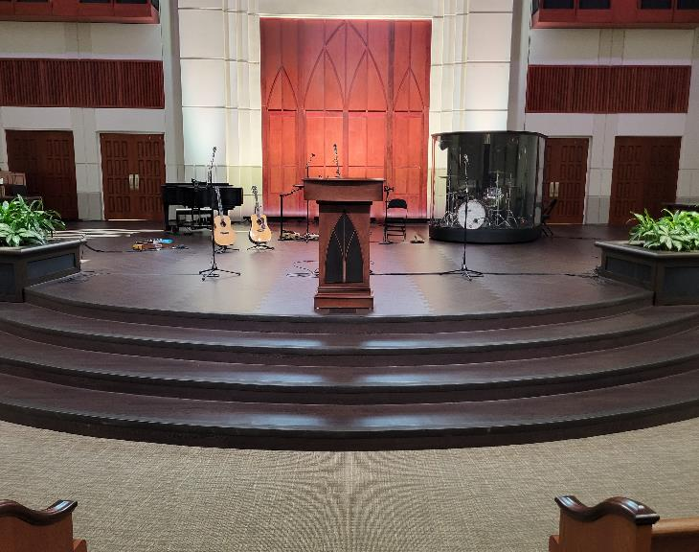
















Massing of the Colors Entry March Process
GUF marches to center stage floor, about faces and presents GUF flag.
SAR U.S. & unit flag team marches to center stage floor cross, then position themselves next to GUF on either side, about face, and present flags.
V01 flag team marches in, cross, and positions 10 feet from SAR flag holders, about face, and presents flags.
V02-V10 flag teams march in, cross and positions 3 feet from V01 flag team and 3 feet between each team, about face, and presents flags.
NCCB stops playing when all VO teams on stage floor are facing audience.
NCCB Singer: National Anthem (NA)
US Flags
Unit Flags
5
5

Slide 6
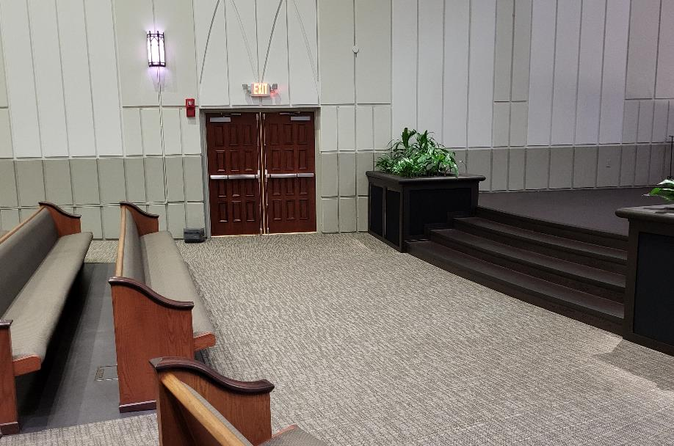


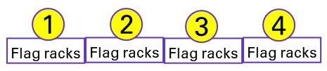

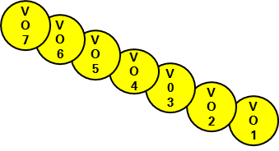

GUF/SAR/VO U.S. Flag Bearers Posting the Colors Process
After national anthem is sung:
MC: “Units-Post the Colors”.
US flag bearers right face, march, then hand flag to CAD, walk to your assigned row and seat, about face and stand with hand salute.
VOs 10-8: Walk to 2nd row seat locations as indicated (blue arrow).
VOs 7-1: Walk to 1st row seat locations as indicated.
SAR then GUF: Walk to 2nd row seat locations as indicated.
CADs rack flags from rear to front of each rack. Example: Rack #4: flag 10 placed in rear, 9 in middle and 8 in front.
  Rack #4: VO flags 10,9,8.
  Rack #3: VO flags 7,6,5.
  Rack #2: VO flags 4,3,2.
  Rack #1: VO flag 1, SAR, GUF
Racking complete: CADs to seats.
MC: “Order Arms“ command.
MC: “Please Be Seated” command.
VO1
VO4
VO7
VO 10
SAR
VO3
VO6
VO9
GUF
VO2
VO5
VO8
CAD
VO7
VO6
VO 5
VO 4
V0 3
S
A
R
US Flags
VO 2
VO 1
S
A
R
G
U
F
G
U
F
Last flag in on posting is first flag out on retrieval.
6

Slide 7
GUF/SAR/VO Unit Flag Bearers Posting the Colors Process Notes
Using the far end pew seats on both sides of the sanctuary, there are 7 seats in each pew row with front 2 rows required. Seating designed to permit CADS and GUF/SAR flag holders to get into position easier when retrieval of the colors occurs.
  1st and 2nd row pews will have signs indicating numbered VO seats, GUF and SAR seats and CAD seats. Save these signs and don’t sit on them.
  2nd row pew seating: VO U.S. flag bearers 8 thru 10 seated in middle of 2nd row. Enter (see blue arrow) from left side of pew (as facing stage).
  1st row pew seating: VO unit flag bearers 1-7 seated in front row with V07 at far left (facing stage) of 1st row followed by 6,5,4,3,2,1.
  2nd row pew seating: GUF and SAR enter from right side of pew (as facing the stage).
  2nd row pew seating: upon all flags racked, CADs go to left side of pew (as facing the stage).
7

Slide 8
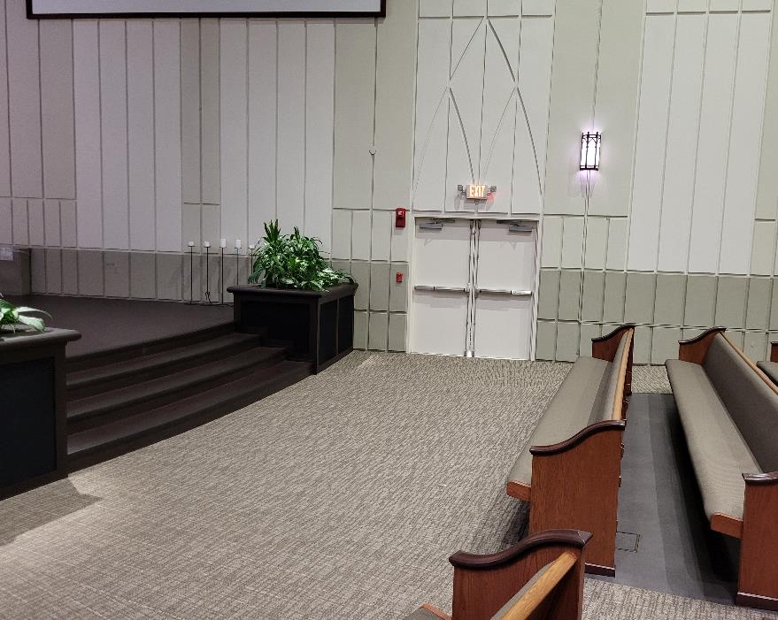


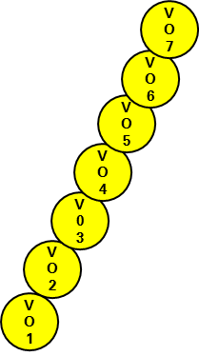

SAR/VO Unit Flag Bearers Posting the Colors Process
After national anthem is sung:
MC: “Units-Post the Colors”.
Unit flag bearers left face, march, then hand flag to CAD, walk to your assigned row and seat, about face and stand with hand salute.
VOs 10-8: Walk to 2nd row seat locations as indicated (blue arrow).
VOs 7-1: Walk to 1st row seat locations as indicated.
SAR: Walk to 2nd row seat location as indicated.
CADs rack flags from rear to front of each rack. Example: Rack #4: flag 10 placed in rear, 9 in middle and 8 in front.
  Rack #4: VO flags 10,9,8.
  Rack #3: VO flags 7,6,5.
  Rack #2: VO flags 4,3,2.
  Rack #1: VO flag 1, SAR, GUF
Racking complete: CADs to seats.
MC: “Order Arms“ command.
MC: “Please Be Seated” command.
Stage Left
VO 10
VO7
VO4
VO9
VO6
VO3
VO1
VO8
VO5
VO2
SAR
VO
8
VO7
VO6
VO 5
VO 4
V0 3
VO 2
VO 1
S
A
R
S
A
R
Last flag in on posting is first flag out on retrieval.
8

Slide 9
SAR/VO U.S. Flag Bearers Posting the Colors Process Notes
Using the far end pew seats on both sides of the sanctuary, there are 7 seats in each pew row with 2 rows required. Seating designed to permit CADS and SAR unit flag holder to get into position easier when retrieval of the colors occurs.
  1st and 2nd row pews will have signs indicating numbered VO seats, SAR seat and CAD seats. Save these signs and don’t sit on them.
  2nd row pew seating: VO unit flag bearers 8 thru 10 seated in middle of 2nd row between CADs and SAR. Enter (see blue arrow) from left side of pew (as facing stage).
  1st row pew seating: VO unit flag bearers 1-7 seated in front row with V07 at far right (facing stage) of 1st row followed by 6,5,4,3,2,1.
  2nd row pew seating: SAR unit flag goes to left side of pew (as facing the stage).
  2nd row pew seating: upon all flags racked, CADs go to right side of pew (as facing the stage).
9

Slide 10

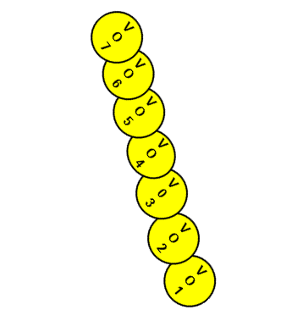
GUF/SAR/VO U.S. Flag Bearer Retiring the Colors Process
MC: “We will end this event by retiring the colors.”
“JROTC Cadets, take your positions to retrieve the flags.”
“Grand Union Flag bearer please take your position” (center stage).
“Sons of the American Revolution flag team, take your positions.”
“Veterans Organizations flag teams, take your positions.”
CADs unrack flags front to rear.
  Rack #1: SAR, VO1
  Rack #2: VO flags 2.3.4.
  Rack #3: VO flags 5,6,7.
  Rack #4: VO flags 8,9.10.
MC: “Ladies and Gentlemen, please rise for the retiring of the colors. Upon my command, place your right hand over your heart. Veterans may present arms with a hand salute.”
MC: “Present Arms”.
NCCB: Starts playing exit music.
VO1
VO4
VO7
VO 10
SAR
VO3
VO6
VO9
GUF
VO2
VO5
VO8
CAD
VO
8
VO7
VO6
VO 5
VO 4
V0 3
VO 2
S
A
R
VO 1
S
A
R
G
U
F
G
U
F
US Flags
10

Slide 11
GUF/SAR/VO U.S. Flag Bearer Retiring the Colors Process Notes
Upon each MC command, the following will occur:
CADs: Cadets walk from 2nd row seats up into rack area position. Retrieve flags from Rack 1 to Rack 4 (last in is first out).
GUF: Walks from 2nd row pew to rack area; receives GUF flag from CAD; then walks to central stage floor, turn to face audience; right shoulder arm position.
SAR: Walks from 2nd row pew to rack area; receives SAR U.S. flag from CAD; then walks to position next to GUF, turn to face audience; right shoulder arm position.
VO1 flag team: Walks from 1st row pew to rack area; receives unit U.S. flag, then walks to position 10 feet from SAR, turn to face audience, right should arm position.
VO 2-7 flag teams: Walk from 1st row pew to rack area; receives unit U.S. flag, then walks to position 3 feet from VO1 flag team (3 feet between each team); turn to face audience; right shoulder arm position.
Once flags are in place, MC will ask audience to rise, then give “present arms” command. All flag bearers will come to attention and present flags.
All units need to identify their US flag in some way (tape with unit identification, etc.) just in case the U.S. flags get mixed up during the retrieval process. Before leaving the event, flags can be exchanged after event.
11

Slide 12
SAR/VO Unit Flag Bearer Retiring the Colors Process
MC: “We will end this event by retiring the colors.”
“JROTC Cadets, take your positions to retrieve the flags.”
“Grand Union Flag bearer please take your position” (center stage).
“Sons of the American Revolution flag team, take your positions.”
“Veterans Organizations flag teams, take your positions.”
CADs unrack flags front to rear.
  Rack #1: SAR, VO1
  Rack #2: VO flags 2.3.4.
  Rack #3: VO flags 5,6,7.
  Rack #4: VO flags 8,9.10.
MC: “Ladies and Gentlemen, please rise for the retiring of the colors. Upon my command, place your right hand over your heart. Veterans may present arms with a hand salute.”
MC: “Present Arms”.
NCCB: Starts playing exit music.
VO 10
VO7
VO4
VO9
VO6
VO3
VO1
VO8
VO5
VO2
SAR
VO7
VO6
VO7
VO 5
VO6
VO 4
VO 4
VO 5
V0 3
VO Unit Flag
V0 3
VO 2
VO 2
VO 1
S
A
R
VO 1
S
A
R
12

Slide 13
SAR/VO Unit Flag Bearer Retiring the Colors Process
Upon each MC command, the following will occur:
CADs: Cadets walk from 2nd row seats up into rack area position. Retrieve flags from Rack 1 to Rack 4 (last in is first out).
SAR: Walks from 2nd row pew to rack area; receives SAR unit flag from CAD; then walks to position next to GUF, turn to face audience; right shoulder arm position.
VO1 flag team: Walks from 1st row pew to rack area; receives unit flag, then walks to position 10 feet from SAR, turn to face audience; right shoulder arm position.
VO 2-7 flag teams: Walk from 1st row pew to rack area; receives unit flag, then walks to position 3 feet from VO flag team in front of them (3 feet between each team); turn to face audience; right arm shoulder position.
VO 8-10 flag teams: Walk from 2nd row pew to rack area; receives unit flag, then walks to position 3 feet from VO team in front of them (3 feet between each team); turn to face audience, right arm shoulder position.
Once flags are in place MC will ask audience to rise, then give “present arms” command. All flag bearers will come to attention and present flags.
13

Slide 14
Massing of the Colors Exit Process
MC command for each flag team type requires walking to your position, turn 45° to face audience, then assume right shoulder arm position (RSAP) for flag before present arms command is given.
GUF: walks to center stage floor.
SAR flag team walks and assumes positions on either side of GUF.
VO1 flag team (U.S. and unit flags), walks to 10 feet on each side of SAR team member.
VO2-10 flag teams position themselves 3 feet from the VO flag team in front of them.
MC: “Present Arms”. All flag teams go from RSAP to attention and present flags
MC: “Retire the Colors” Remember no crossing of flags necessary.
NCCB STARTS PLAYING.
VOs 1-10 march up center aisle 10 feet apart.
SAR flag team follows last VO team (10 feet apart) and GUF follows SAR team (10 feet apart).
Flag teams go position in Narthex in same parade rest positions as in beginning of ceremony.
U.S Flag
VO Flag
U.S
14

Slide 15
Exit Sequence
Flag teams position themselves in the narthex in the same parade rest position as at the beginning of ceremony.
Assume parade rest positions allowing attendees to pass by the flags as they exit the Narthex (normally 10+ minutes).
EXIT
VO7
VO7
VO6
VO6
VO 5
E
X
I
T
VO 5
VO 4
VO 4
V0 3
V0 3
VO 2
VO 2
VO 1
VO 1
S
A
R
15

